Slide 1
Graph Databases for Code Analysis
Notes:
Hi! Thanks for your interest in this talk! My goal for today is to give you an introduction to graph databases and how they compare to relational databases. Specifically we'll look at how you'd model a particular domain (you guessed it: code analysis), and how to write a few basic queries.
To frame this talk: here at ShiftLeft, we develop a code analysis tool to find vulnerabilities, data leaks etc. in your code. We use code property graphs as a way to represent specific elements inside an application, e.g. methods, calls, parameters etc.
More importantly though, we're interested in the ways they interact with each other.
In this session I'll explain how the technology behind that works.
It certainly helps if you have some basic knowledge of any query language. Most folks learnt SQL at some point. But this isn't essential to understand the gist of this talk.

Slide 2

Who am I?
Michael Pollmeier
Principal engineer in the ShiftLeft Code Science team
  Part of the initial crew @ShiftLeftring
Scala, Graph Databases and Open Source fan
  gremlin-scala: a tinkerpop language variant for Scala
  overflowdb: in-memory graph database with a low memory footprint
  Apache committer, contributor to various OSS projects
@pollmeier

Slide 3
ToC
What's a Graph Database?
Code analysis domain model: graph and relational
SQL injection: building up a traversal in small increments
Summary
Notes:
summary: key takeaway points

Slide 4
What's a graph database?
Nodes with properties
Directed edges with properties - first class citizens!
Modelling compatible with human mind
Node A
property1
Node B
property1
property2
Edge C
property1
Notes:
A graph database quite simplistic at it's foundation: there are only nodes and edges between nodes, in other words there are things and connections/relationships between things. Both nodes and edges have labels and properties. And that's about it.
The important part is that graph databases are designed to treat the relationships between data as equally important to the data itself.
The edges are first class citizens. That's one major difference to relational databases, where relations are expressed via lookup columns or even lookup tables.
Let's now take a look how you'd model an example domain on a whiteboard, with a graph db and with a relational db.
We'll use code analysis as our example domain. You'll see that there's much less mind-bending required compared to relational databases.

Slide 5
Code analysis domain model: whiteboard sketch
Graph
METHOD
name
signature
EXPRESSION
label: literal, call, …
TARGET
ARGUMENT
index
CALL
Notes:
Ok so here's a whiteboard sketch for the code analysis domain - or rather an excerpt of it. There are methods, which have a name and signature property. There are Expressions, which could e.g. be a string literal in the simplest case. And let's add method calls to the mix. A method call 'targets' a method and passes expressions as arguments.
Now how would you model that with a graph? Actually, exactly like on a whiteboard. That's because we have nodes and edges as first class citizens. (Labels btw give us a bit more flexibility than tables in relational dbs - depending on the graph db they tend to be just loose coupling of nodes.)
For comparison, let's see how you'd model this in a relational database, i.e. with tables.

Slide 6
Code analysis domain model
Relational
Graph
METHOD
name
signature
EXPRESSION
label: literal, call, …
METHOD
name
signature
EXPRESSION
type: literal, call, ...
literal_id
call_id
...
TARGET
ARGUMENT
index
CALL
target_method_id
CALL_ARG_IDX
call_id
expression_id
argument_index
CALL
Notes:
Left side: graph db, right side: relational db.
A few things are identical, e.g. there are methods with name/signature/... properties.
Now let's focus on the differences:
1) target edge (call -> method): separate column in call table (1:1 relationship)
2) argument edge (call -> expression): 1:many relationship, therefor we need a separate lookup table: call_arg_idx. That separate table is also where we store the argument index.
Bottom line: Relational dbs are not good at modelling relationships. It's simple for a 1:n or 1:1 relationship where we can just link two tables with an id. But as soon as we have m:n relationships, we need to resolve that via a separate table.
3) Expression: this is one way to model it: expression type enum: literal, call, ... and a link to the 'actual' expression id.
Alternatively, we could cramm all expression types into one table with wide rows.
But either way, you have to bend your mind a bit more in comparison. And you need to join one more table at query time.
Bottom line: graph labels are more flexible than tables.
Ok, so this was an overview of the difference in modelling between graph and relational databases.
Next, let's see what that means for querying the data.
We will build up a traversal for finding a sql injection with both a graph traversal and a sql query. To make it easier to follow we'll do that in a few iterations over the next few slides.

Slide 7

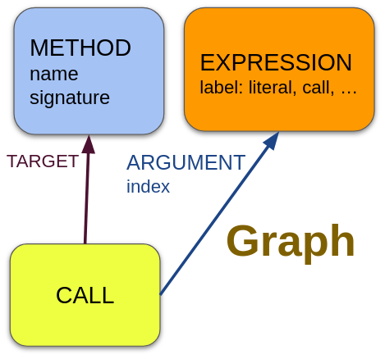
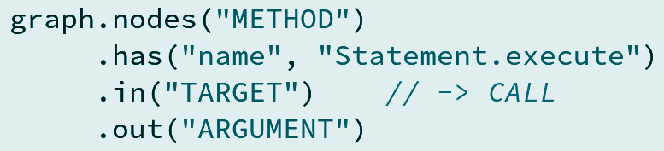
1: Method call, passing a literal as argument
Notes:
We start with this simple piece of code: there's a string literal called 'sql' which is being passed to a database.
For your understanding: in code analysis, our starting position is that we already know that certain methods are interesting. In this case we know that `Statement.execute` is worth looking at, since it's arguments are ultimately passed down to your database.
In this example a simple string literal is passed down. So how do we figure that out in our code analysis domain that we introduced in the last slides? Here's an example query based on overflowdb's query language, which is very similar to gremlin, if you've heard about that one before.
CLICK
graph: of all method nodes, find the one hat has the name 'Statement.execute'.
then follow the incoming TARGET edge to see where it's being called.
from the call, follow the outgoing ARGUMENT edge, and voila we are at the expression, in this case our literal
This talk is not really about performance differences, but it's worth pointing out that these IN/OUT steps are O(1), i.e. constant time, i.e. they don't become more expensive only because there are 20x as many methods in the graph.
NEXT: now let's see how we can do the same thing in SQL

Slide 8
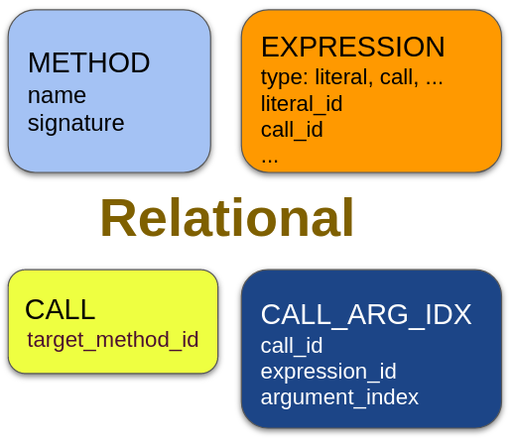
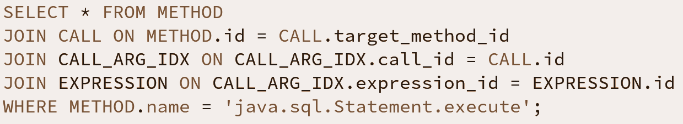
1: Method call, passing a literal as argument
Notes:
How would we write the same query in SQL, i.e. find the method we're interested in and figure out what it's being called with?
Essentially the query is doing the same thing: find the method with that particular name, then join the ...
Main difference: much longer, mostly because we need to specify which ids to match when joining a table at query time.
-> relationships are reified at query time, which is wordy and error prone. the strong point of declarative query languages is usually that you declare WHAT you want, not HOW to get there. In SQL, you actually need to take care of both.
-> error prone: easy to lookup the wrong id
-> more text makes it harder to read
-> 'select from method' and 'where method.name' are not directly together
-> performance note: you need to take care of creating the right indices for the lookup columns
Passing a string literal to your database won't allow for a sql injection, so let's modify the example a bit.

Slide 9
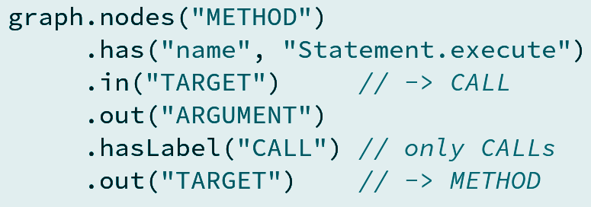
2: Call argument is another method call
Notes:
Instead of the string literal, we are now passing the input from a servlet directly to the database. This is quite obviously a sql injection - so let's check how we'd query that in our domain. Let's start again with the graph traversal:
CLICK
graph: just like before: of all method nodes, find the one hat has the name 'Statement.execute'.
then follow the incoming TARGET edge to see where it's being called.
from the call, follow the outgoing ARGUMENT edge, and just like before, we are at the expression
differently to the first case, we're only interested in arguments that are themselves calls (hasLabel(CALL)),
and from there we can traverse to the method that's being called and we've reached servlet.inputParameter
NEXT: now let's see how we can do the same thing in SQL

Slide 10
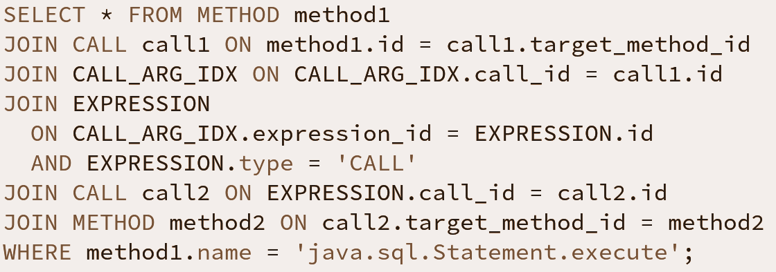
2: Call argument is another method call
Notes:
Now this is getting a bit hard to read and follow in SQL. I won't go into every detail, but you can trust me that we're essentially doing the same thing, only that we have to go via lookup tables and join ids manually, just like before.
The first example already showed how much more complex a sql statement is, in comparison to a graph traversal. Making the example slightly more complicated takes it to the next level. It's very hard to follow what's going on, also since we need to join the same table multiple times and give them different aliases. Compare that to the graph traversal where we simply describe which outgoing/incoming edges we want to follow.
This is probably enough to show the beauty of graph traversals in comparison to SQL, but we the code we're analysing is still far too simplistic to be found in real life. No one in their good mind sends the SQL statement from the client to the server. Instead, real SQL injections stem from user input that goes through an arbitrary number of method calls, and finally ends up in something like `Statement.execute`. Let's modify our example further.

Slide 11
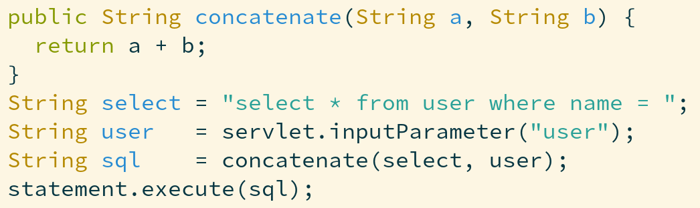
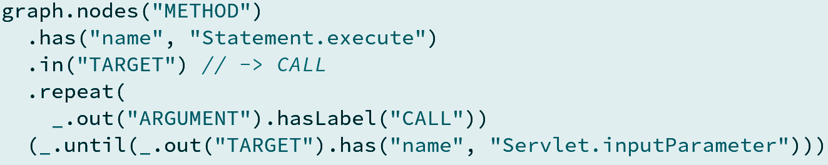

3: Chain of method calls of arbitrary length
Notes:
So now we have a string literal which contains half a SQL query. And we have the user input which comes from a servlet, which is a method call. Both are passed through one method, but may as well go through 10 additional methods. How would we find something like that in a graph traversal?
Again, we're starting with a lookup of methods with the name `Statement.execute` and traverse to where they are called.
Now comes the new part: meet the `repeat` step! We repeat the given query, i.e. traverse to the call argument, where we're only interested in calls.
Repeat that, until we are at a call, whose target method name is `Servlet.inputParameter`.
So what have we done here? We have some prior knowledge about interesting methods, and want to see if they are connected via method calls in any way. The graph traversal is very expressive about what it does.
`repeat` exists in all major graph traversal languages, but does not exist in SQL.
If you try the same with a relational database, you'd probably have to handle the 'repeat' logic inside your application logic, going between app and database back and forth.
To sum up the traversal section of this talk: graph databases are designed for allowing to finding connections between things, even connections of arbitrary length. SQL is very noisy and hard to read for this, and doesn't support the 'arbirary length' part at all.

Slide 12

The ?
For code analysis: maybe
Not as mature as Relational DBs
https://github.com/ShiftLeftSecurity/overflowdb
Notes:
As always: choose the right tool for the job. for code analysis and similar highly-connected domains, graph dbs work really well
sql and relational dbs are years of research and wide adoption ahead, have proper standards and committees etc.
Databases and tooling not as mature as Relational DBs - still a niche technology. It's fun to be off the beaten track though!
ShiftLeft is actively changing this - we are developing everything graph related as open source: overflowdb

Slide 13
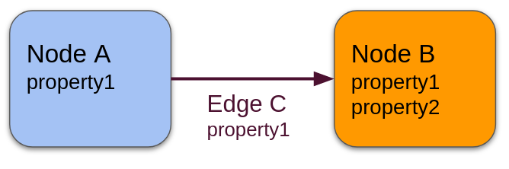
Summary
Nodes and directed edges
  relationships are first class citizens
  Modelling compatible with human mind
Traversals very expressive
  no need to reify IDs in joins
  Repeat step
Still a niche technology
Notes:
As always: choose the right tool for the job. for code analysis and similar highly-connected domains, graph dbs work really well
sql and relational dbs are years of research and wide adoption ahead, have proper standards and committees etc.
Databases and tooling not as mature as Relational DBs - still a niche technology. It's fun to be off the beaten track though!
ShiftLeft is actively changing this - we are developing everything graph related as open source: overflowdb

Slide 14
Thank you!
Notes:
Thank you very much for your interest in this talk! I hope you learned something and gave you some insight into how ShiftLeft works behind the curtain. As a joern or ocular user, you're actually directly exposed to the graph database, since they let you write database traversals, along with our CPG-specific DSL.
I suppose this concludes our little "shifting left '21" conference, over to you, Alok!

